Slide 1


Social Buzz: Data Analysis

Slide 2


Today's agenda
Project recap
Problem
The Analytics team
Process
Insights
Summary

Slide 3

Over the past 5 years, Social Buzz has reached over 500 million active users each month. They have scaled quicker than anticipated and need the help of an advisory firm to oversee their scaling process effectively.
=> Accenture are focusing, during the present 3 months on:
- An audit of their big data practice
- Recommendations for a successful IPO
- An analysis of their content categories that highlights the top 5 categories with the largest aggregate popularity
Project Recap

Slide 4

Problem
Every day over 100,000 pieces of content
=> 36.500.000 pieces of content/year
How to use this huge amount of data to identify the trending content?
An analysis of the content categories to highlight the top 5 categories with the largest aggregate popularity.

Slide 5



Chief Technology Architect​
Andrew Fleming
The Analytics team
Senior Principal​
Marcus Rompton
Data Analyst
Chaima

Slide 6
Process
1
Understand the data
2
Clean the data
3
Data Model
4
Data Analysis
5
Uncover the insights

Slide 7

Insights
Total Number of Posts:
24573
Number of Categories:
16
The month with the most posts:
Mai --> 2138 posts

Slide 9
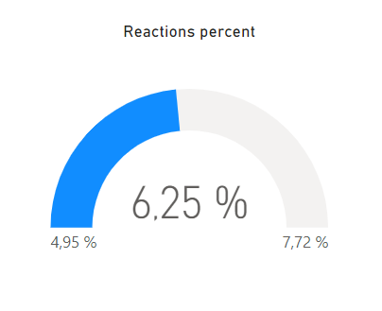
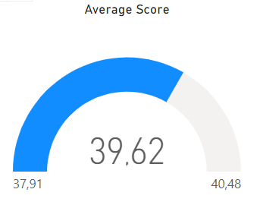

Slide 10
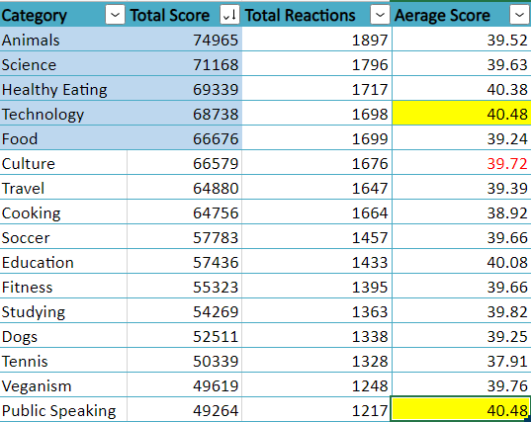

Slide 11

Analysis & Insights
The top 5 content categories are the most seen categories: Animals, Science, Healthy Eating, Technology, Food
=> Life style topics & Products
The top 5 content categories are not the categories that have the highest average score.
=> Possibilities of improving the content quality.
The average number of posts per month is : 2048 posts/Month
=> Stability among the different months of the year.
Next steps: Large scale Analysis..
Summary

Slide 12
Thank you!
ANY QUESTIONS?

